Slide 1
SI Units—Who Cares? (Why Does It Matter?)
Lorrin R. Garson
OPCUG & PATACS
March 21, 2020
© 2020 Lorrin R. Garson
Notes:
Last Edited March 21, 2020 @ 9:03 am
Number of hypertext links = ~40

Slide 2
Being Forthright
Information is presented at a “Dick & Jane” level of chemistry, physics and math
Full understanding requires a grasp of quantum mechanics
Omitted details results in inaccurate statements
In-depth coverage requires a graduate level course in quantum physics or chemistry
No condescension is intended

Slide 3
Imagine…
If each city used a different measure of weight
If every gas station had its own nozzle size or plug for charging electric vehicles
If every lamp manufacturer had a different size bulb socket
If every electrical appliance required a different voltage

Slide 4
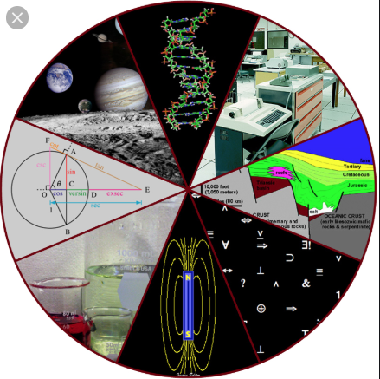
The Sciences & Engineering Also Need Standards*
* For both pure science and applications

Slide 5
Why Are Standards Important?
Standards facilitate innovation in commerce, communications, manufacturing, and science
Standards have a profound direct and indirect impact on society
Standards in the sciences—serve as a model
Standards are established and used internationally
BTW—English is the dominant international language of science and business. English is a standard
Notes:
The state of Indiana tried to legislate Pi to be 3.2 in – in 1897

Slide 6
An Important Historical Event
May 20, 2019
The seven basic SI* standards were defined in terms of constants based on natural phenomena
These seven standards are interrelated
Active link 
* SI comes from Système International d'Unités
aka the metric system
Notes:
The General Conference on Weights and Measures (CGPM)*
A committee of the Bureau International des Poids et Mesures—established by the Metre Convention

Slide 7
Wow!
World Has
Sensational
New
Standards!

Slide 8
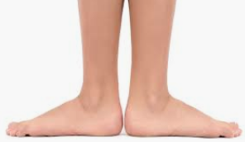
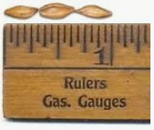
A Little History—Length
12th century: 1 foot = length of the foot of King Henry 1st of England
14th century: 1 inch = length of three barleycorns, King Edward 2nd of England
Note the king’s flat feet ➔
Back to barlycorns and king’s feet after BREXIT?

Slide 9
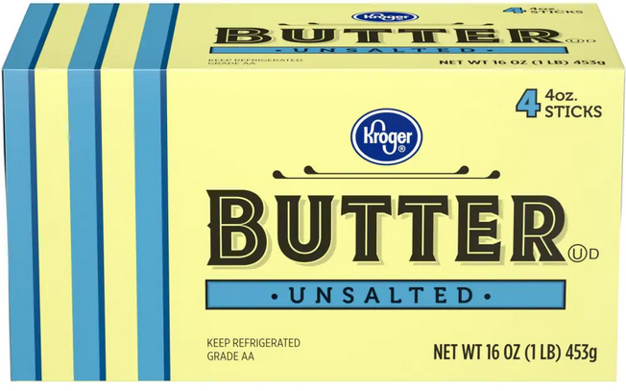
Weight
Our pound is derived from the Roman unit of weight, the libra
1 avoirdupois pound = 453.59237 g
LiBra
0.45359237 kg

Slide 10
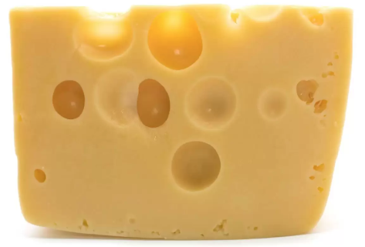
Difference Between Weight and Mass
Weight on the earth…
1 lb. or 0.453592 kg
Weight on the moon…
0.165 lb.
The mass of the cheese is 0.453592 kg anywhere
Weight is a function of gravity—mass is not
Notes:
Gravity on the moon is about 1/6th that of the earth.

Slide 11
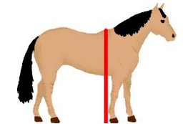
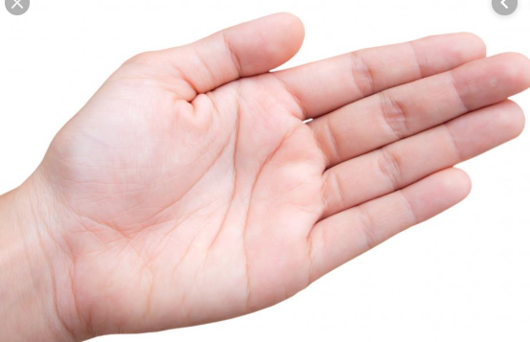
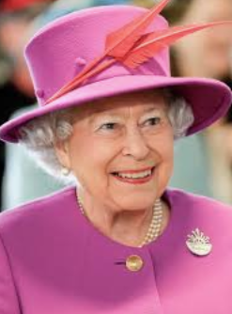
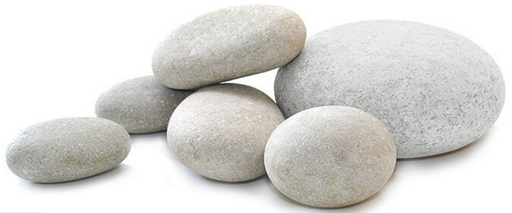
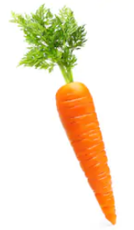
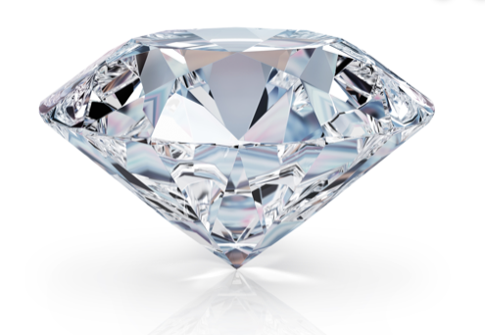
A Little Strangeness
Height of horses
1 hand = 4 in.
Weight of people in the UK
1 stone = 14 lbs.
Weight of diamond
1 carat = 0.2 g or 0.007 oz.
1 carat = 0.00705479239… oz

Slide 12
Three Systems of Measurement
United States Customary Units
Imperial System of Units
International System of Units (SI)
Notes:
Frequently the Imperial System of Units and United States Customary Units are thought of as the same; they aren’t.
1 imperial gallon = 1.2 US gallons (Canada until 1970)

Slide 13
Who Uses What?
United States Customary Units
United States
Canada (sort of) and the U.K (sort of)
Myanmar (formerly Burma)
Liberia
International System of Units (SI)
Everybody else!
⬅ 216 pp.
 
Detailed, authoritative
information about SI Units
Notes:
The metrication of Canada took place in 1975-1985. Still some carry-over to the Imperial System
The far right link references a 216 pp document

Slide 14
Who Uses What?
Imperial System of Units
Mandated by the British Crown in 1824
Former British colonies
Little used
Notes:
1 imperial gallon = 1.2 US gallons (Canada until 1975 to 1985)
The U.K. has used the metric system since 1965, but… not for distances, speed, and liquid quantities

Slide 15
Use of the Metric System in the U.S.
Virtually all the sciences
Engineering (metric and U.S. Customary Units)
1999: Loss of Mars orbiter ($125 million)
1983: Air Canada flight ran out of fuel*
Medicine
U.S. military
Some manufacturing
*Known as the “Gimli Glider”
Notes:
Mars Orbiter lost because of errors in translating U.S. units to metric.
Air Canada disaster is known as the “Gimli Glider” as it ran out of fuel over the town of Gimli, Manitoba
Loaded pounds of fuel instead of kilograms

Slide 16
The Mendenhall Order of 1893
April 5, 1893. Thomas Mendenhall issued “Bulletin No. 26—Fundamental Standards of Length and Mass” (U.S. Coast and Geodetic Survey)
The avoirdupois pound was defined as 2.20462234 lbs. per kilogram
The yard was defined as 3600/3937 of a meter
3600/3937 yard = 1.0000020002187 meter

Slide 17
What are the Seven Basic SI Units of Measurement?
Length (meter)
Time (second)
Mass (kilogram)
Temperature (°K)
Electric Current (ampere)
Luminosity (candela)
Mole (number of atoms)

Slide 18
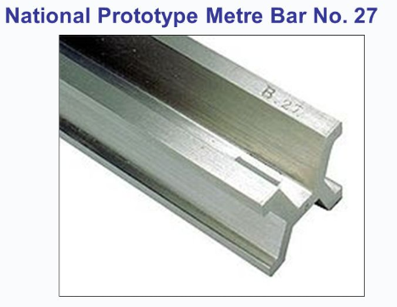
Length—The Meter
Symbol m
1793: 1/10,000,000 of the distance from the equator to the north pole through Paris
Until May 20, 2019, the length of a Pt/Ir bar
The speed of light in a vacuum is 299,792,458 m/s (± 1.1m/s)
The meter is the distance light travels in a vacuum in 1/299,792,458th of a second
For more information see
Notes:
299,792,458 m/s = 186,282 miles/hour

Slide 19
Time—The Second
Symbol s
When ¹³³Cs is bombarded by a laser, a single electron in the outer shell will cycle back and forth between two states*
A second is defined as 9,192,631,770 cycles between these two states
* Known as hyperfine transition
Notes:
There are 40 isotopes of Cs, 133 is the only one stable

Slide 20
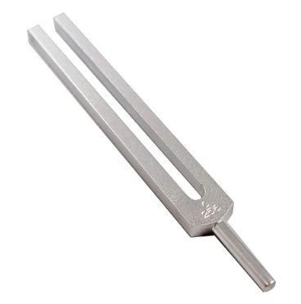
Time—The Second (cont.)
What is a hyperfine transition?
Think tuning fork…
Accuracy of atomic clock
± 1 second in 300 million years*
GPS (Navstar)—24 satellites with 4
atomic clocks in each satellite
Position based on time it takes
for signals to travel to the GPS
For more information see
256 Hz
“C” note
* 300 million years = 9,467,280,000,000,000,000,000,000 seconds
* 300 million years = 9.46728 x 10²⁴ seconds
Notes:
Into the world of quantum mechanics
A GPS needs signals from 4 satellites to determine position

Slide 21
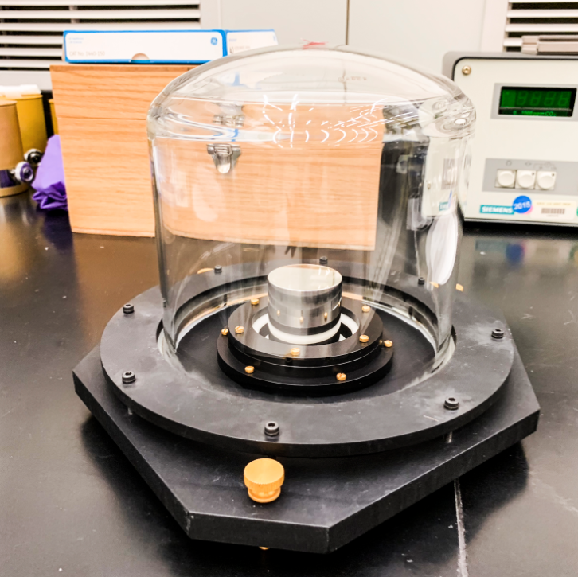
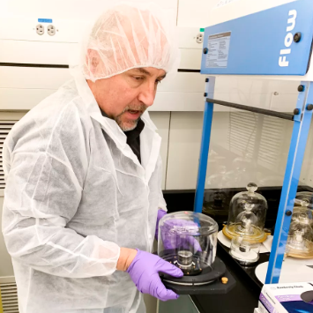
U.S. Standard Kilogram Until May 20, 2019
Oops!
The U.S. Kilogram
Patrick Abbott
“Keeper of the Kilo”
Notes:
At NIST, just off highway 270 in Gaithersburg, Maryland
The standard kg in Paris has lost about 50 micrograms over 120 years (billionths of a kilogram)

Slide 22
Mass—The Kilogram
Symbol kg
The kilogram is expressed in terms of Planck’s constant (defined to have the exact value of h = 6.62607015 x 10^{–34} J.s)
1 joule (J) = 1/3600 of a watt-hour
joule = kg.m²/s²
Planck’s constant describes the proportionality of energy of a photon to its frequency
For more details see
E= mc²
0.000000000000000000000000000000000662607015 J.s
Notes:
33 zeros preceding 662…
In E = mc^2, E in in joules, m in kg and c in meters/second
Planck’s constant can be thought of as the energy of a photon
Accuracy of Planck’s constant is ± 10 parts per billion in measurement
s = seconds
m = meter
Ultraviolet light has a higher frequency than visible light

Slide 23
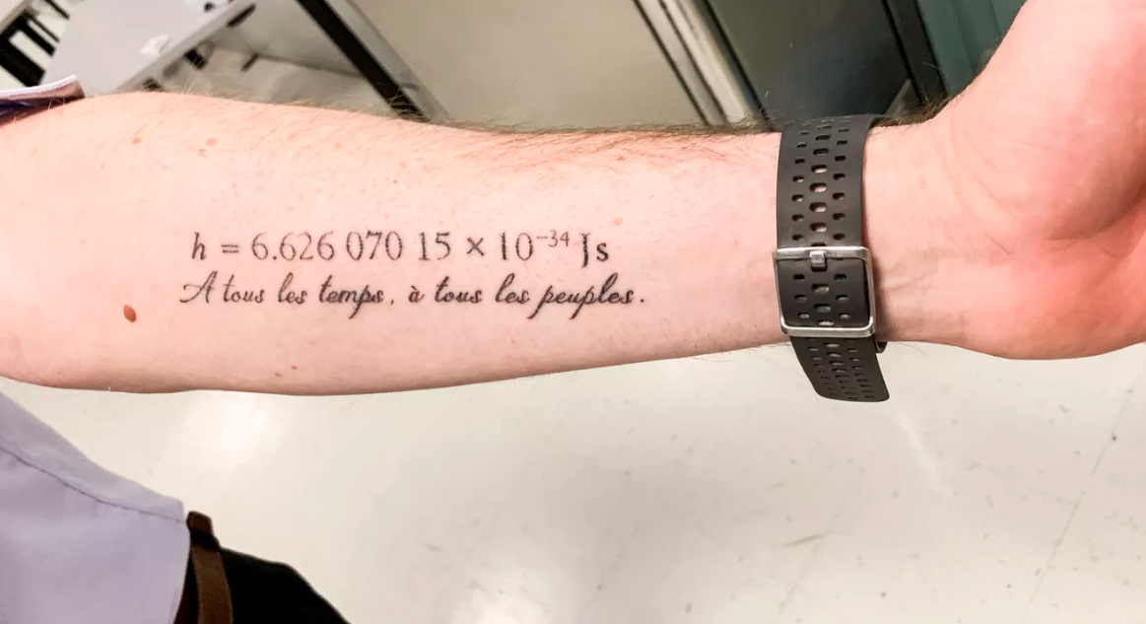
Stephan Schlamminger’s Left Arm
“Planck? Don’t you mean plank?
“For all times, for all people”
Notes:
Note the watch band

Slide 24
Temperature—Kelvin
Symbol K
“Absolute Zero” aka “infinite cold”
0°K = –273.15 °C = –459.67 °F
72 °F = 22.22 °C = 295.37 °K
Kelvin is defined in terms of the Boltzmann constant (1.380649 x 10^{–23} J/K)
For more information see
Coldest attained temperature—He cooled to 0.0001 °K
➲
➲
Notes:
Note: Boltzmann constant has terms of energy and temperature
Boltzmann constant relates kinetic energy to temperature

Slide 25
Temperature—Kelvin (cont.)
↓ Pressure (atm)
↓ Volume (L)
↓ Temperature (°K)
PV = nRT
Ideal Gas Law
Mass (mol) ↑
↑ R = 0.082057366080960 atm-L/mol- °K
↓ Pressure (Pa)
↓ Volume (m³)
↓ Temperature (°K)
PV = NkT
Boltzmann constant ↑
Number atoms ↑
or molecules
Notes:
1 atm = 101,325 Pa
Pa = N/m²
Newton is N
N = kg/m²

Slide 26
LED Light Bulbs and °K
2000K to 3000K
3100K to 4500K
4600K to 6500K

Slide 27
Electrical Current—The Ampere
Symbol A
The ampere is based on the amount of electric charge of a single electron (negative) or proton (positive)
The ampere is a measure of the amount of electric charge in motion per unit time ― i.e., an electric current
Notes:
Ampere = 1 coulomb per second

Slide 28
Electrical Current—The Ampere (cont.)
One ampere is the current in which one coulomb (symbol C) of charge travels across a given point in 1 second
C = 6.241509074460762 x 10¹⁸ electron charges (e)*
* 6,241,509,074,460,762,000 electron charges
Notes:
C has 16 significant figures

Slide 29
Luminosity (Light)—Candela
Symbol cd
A common wax candle emits light with a luminous intensity of roughly one candela
Light intensity is often expressed in lumens
Lumen ≠ candela
A lumen is equal to the amount of light emitted per second in a solid angle of one steradian from a uniform source of one candela
Notes:
Until 1973, beacons at lighthouses were described in terms of candlepower

Slide 30
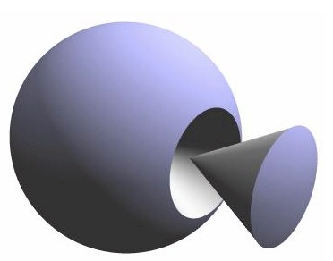
A Steradian
A steradian is equal to the angle at the center of a sphere subtended
by a part of the surface equal in area to the square of the radius
⬅ a steradian
The angle ➔
C
⬅ A = r²
A sphere has 4 $π$steradians
Notes:
There are 2 radians in a circle (360 degrees); 1 radian = 180 degrees

Slide 31
Luminosity (Light)—Candela (cont.)
“One candela is the luminous intensity, in a given direction, of a source that emits monochromatic radiation of frequency 540 × 10¹² Hz and that has a radiant intensity in that direction of 1/683 watt per steradian”
The candela is defined in terms of other basic standards (kilogram, meter, second)
Notes:
540 x 10¹² Hz is 540 nm (nanometers); a yellowish green light that humans see very well

Slide 32
Luminosity (Light)—Candela (cont.)
At present the candela can only be measured to within one part in a thousand (0.1%)
Improved measurement techniques will result into a more precise value for the candela
…but the phenomenon on which the candela is based remains constant

Slide 33
The Mole
X

Slide 34
The Mole—Amount of Substance
Symbol mol
Old Definition: amount of substance containing as many atoms or molecules as there are atoms in 0.012 kg of carbon-12
Challenge: How do you determine the number atoms in 0.012 kg of ¹²C?

Slide 35
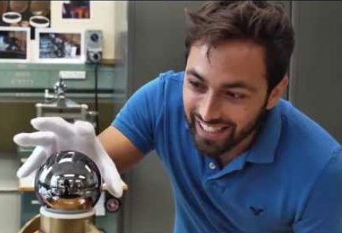
Amount of Substance—The Mole (cont.)
Current standard based on Planck’s constant
The effort of several international groups working on a 1 kg sphere of ²⁸Si using…
Mass spectrometry
Interferometric measurements
X-ray crystallography
Avogadro’s Constant (N_{A}): 6.02214076 x 10²³ (± 0.00000018 x 10²³) atoms or molecules/mole*
References
$3.2 M
* 1 mol ²⁸Si = 27.9769265325 g
Notes:
Interferometry used to measure the dimensions of the Si sphere
Purity: Greatest impurity is Cu, 1 Cu atom to 3 billion atoms Si
Spherical? Expanded to size of earth, deepest ocean to highest mountain 3-5 meters (10-15 feet)
There are 23 isotopes of Si. Three are stable: 28 (92.2%), 29 (4.7%), and 30 (3.1%)

Slide 36
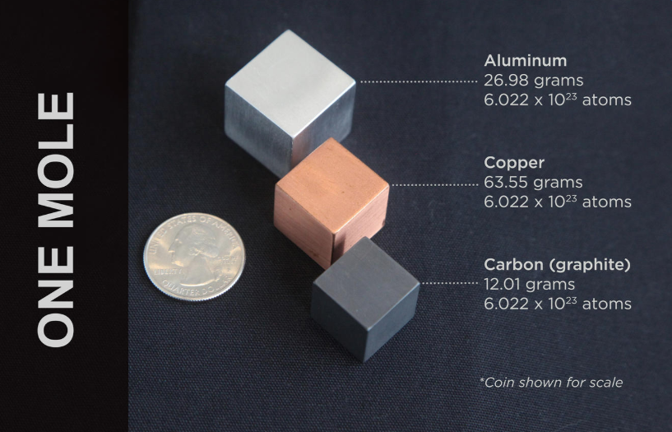
→
18.015 grams water (H₂O)
6.022 x 10²³ molecules

Slide 37
Additional References
SI Units, basic information (a 4-minute video)
Recommended CODATA values for physical constants*
NIST: The International System of Units (SI) [2019]
Wikipedia: 2019 Redefinition of the SI Base Units
NIST: Redefining the World’s Measurement System
Some YouTube Videos:
New definitions for SI units
SI System | What Changes in 2019?
The kg is dead, long live the kg
Voting on the new SI Units
* 1,605 pp.
Notes:
CODADA reference is 1605 pp. long
CODATA is the Committee on Data of the International Science Council

Slide 38
Thank You!

